Slide 1
Lecture 18: Machine Translation: History, Evaluation
USC VSoE CSCI 544: Applied Natural Language Processing
Jonathan May -- 梅約納
November 1, 2017
slides from Philipp Koehn

Slide 2
Updates
Regrades for explanation.txt, midterm still being processed
An additional file, twitter_test.ner, is uploaded to blackboard (by itself and in an amended package)
HW6 due November 10 (one week from Friday)

Slide 3
Today
Introduction to MT
Evaluation of MT
Intuition behind learning word translations

Slide 4
Translation is a Very Old Problem
The Tower of Babel (Peter Bruegel the Elder, 1563)

Slide 5
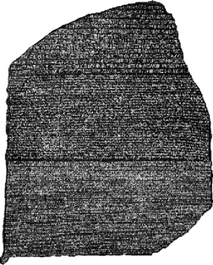
Translation is a Very Old Problem
Rosetta Stone
Hieroglyphics, Demotic, Ancient Greek
Translated 1803-1822
Advantage: we already knew some Ancient Greek!

Slide 7
Early Efforts and Disappointment
Excited research in 1950s and 60s
1954 Georgetown experiment: Machine could translate 250 words and 6 grammar rules
1966 ALPAC report:
only $20m spent on translation in the US/year
not that much Russian we want to translate
Money is better spent teaching humans Russian!

Slide 8
Rule-Based Systems
General approach:
build dictionaries
write transformation rules
refine, refine, refine
Météo system for weather forecasts (1976)
Canadian French-English
Success story! Limited domain
Systran (1968)
Offshoot of Georgetown experiment
Still around! Rule-based until 2010. Now based in France.
Logos, Metal (1980s)

Slide 14
Machine Translation: Samoan
O lenei tulafono taufa’aofi mai le faigamalo a Lolo ma Lemanu, na taunu’u i luma o le Fono Faitulafono i le vaiaso mulimuli o galuega a maota e lua, ma faia ai loa le fa’aiuga ina ia taofia le iloiloina o nei tulafono seia toe a’e mai galuegaa le Fono i le tauaofiaga lona 3, lea e fa’amoemoe e usuia i le aso Gafua lona 2 o le masina o Iaunari 2018.
=Monday
This lawyer from the government of Lolo and Leman came before the Legislative Assembly in the last week of the two cabinets, making the decision to stop the review of these law until the Council's return to the third session, which is expected to be held on the 2nd of the month of June 2018.
June = Malelaga

Slide 15
Machine Translation: Oromo
Hanbaan dhukaatuu ykn boombii qaama xayyaaricha caccabee fi meeshaa imaltootaa irratti argameera .
Hanbaan dhukaatuu or the bomb was found on the imaltootaa body xayyaaricha caccabee and equipment.
MT:
The remnants of explosives or bombs were found on the fragments of the airplane and the belongings of the travellers.
Truth:

Slide 16
Two Kinds of Error
Fluency: Is it good English (or other target language)?
Grammatical Correctness
Idiomatic Word choice
Adequacy: Did the meaning of the input get properly conveyed?
Info lost
Extra info added
Worst of Both Worlds:
word salad
untranslated words

Slide 17
Is It Good Enough?
Depends on what you want to do with it...
Assimilation: reader initiates translation, wants to know content
user is tolerant of inferior quality; gist is fine
focus of majority of research
Communication: participants don't speak same language, rely on translation
users can ask questions when something is unclear
chat room translations, hand-held devices, combined with speech recognition
Dissemination: publisher wants to make content available in other languages
high demand for quality
mt not sufficient; done almost exclusively by human translators
but mt is used as first pass to speed things up

Slide 18
How To Do It

Slide 19
Vauquois Triangle
Interlingua
Semantic Transfer
Ambiguity!
Syntactic Transfer
Analysis
Generation
Lexical Transfer
Source
Target
number of examples needed

Slide 25
Vauquois Triangle
Interlingua
Semantic Transfer
Ambiguity!
Syntactic Transfer
Analysis
Generation
Lexical Transfer
Source
Target
number of examples needed

Slide 26
But First, How Do We Know If We're Doing a Good Job?

Slide 27
-- cross-lingual information retrieval results

Slide 39
Running Example
Reference:
Israeli officials are responsible for airport security
Machine Translation:
Israeli officials responsibility of airport safety
What score should this get?

Slide 40
But "airport are for Israeli officials responsible security" has an F of 100%!

Slide 41
BLEU
N-gram overlap between machine translation output and reference translation(s)
Compute precision for n-grams of size 1-4
Take the geometric mean (multiply together, take 4th root)
Add brevity penalty for too short translations
Otherwise, you could maximize score by finding one perfect 4-gram and ignoring the rest of the sentence
Typically calculated over entire corpus, not single sentence

Slide 42
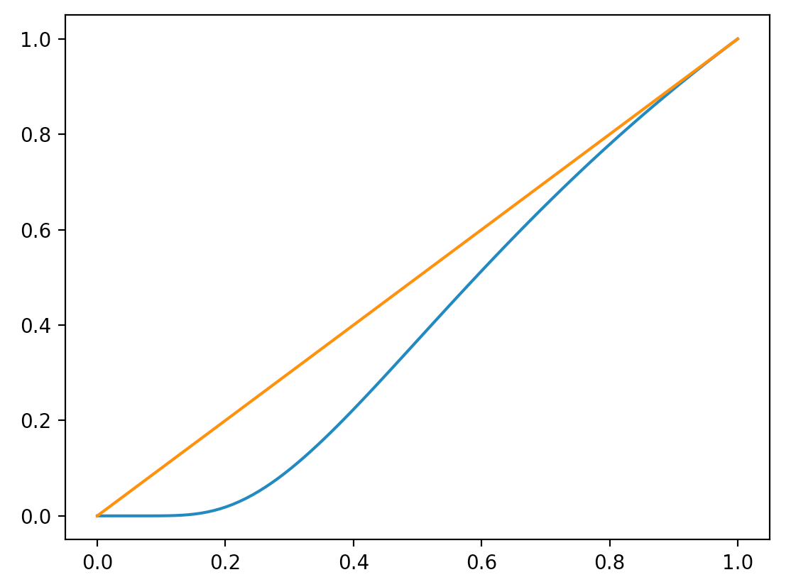
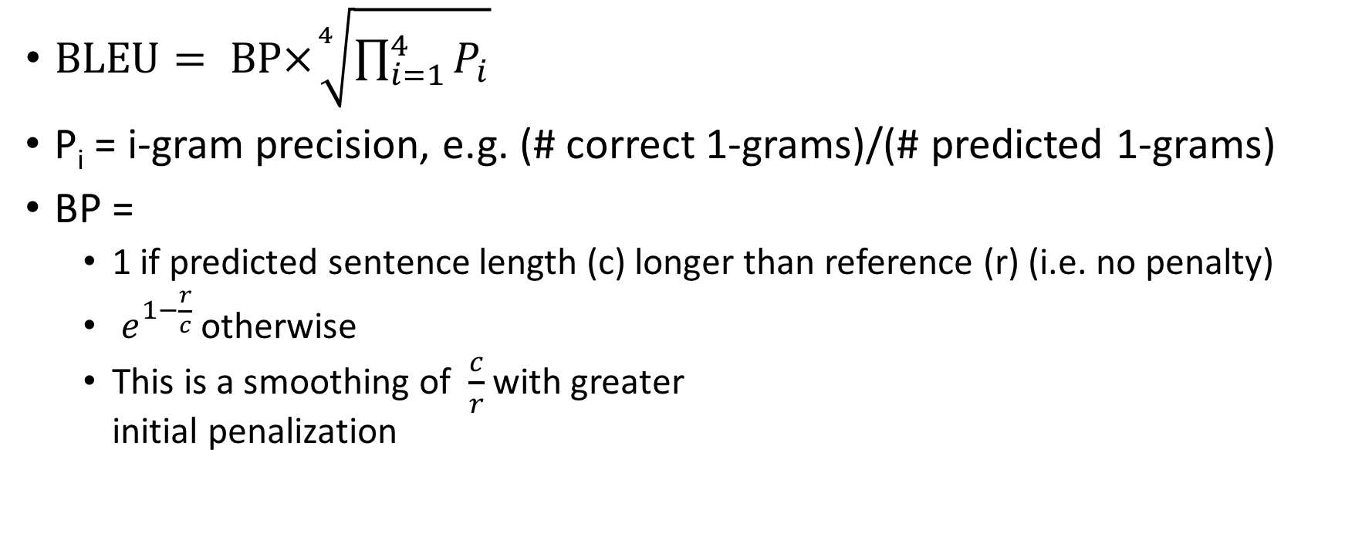
BLEU
$\text{BLEU}= \text{BP}×\sqrt[4]{\prod_{i=1}^{4}{P_{i}}}$
P_{i} = i-gram precision, e.g. (# correct 1-grams)/(# predicted 1-grams)
BP =
1 if predicted sentence length (c) longer than reference (r) (i.e. no penalty)
$e^{1−\frac{r}{c}}$ otherwise
This is a smoothing of $\frac{c}{r}$ with greater initial penalization

Slide 43
Historical Notes: Why is it called BLEU?
Invented at IBM
Backronym: "BiLingual Evaluation Understudy"
Ugh: two acronym violations (mid-word, forced term)
But the name stuck!

Slide 44
Example
Input Foreign Sentence:
<DOESN'T MATTER!>
"Gold" Reference Sentence:
Israeli officials are responsible for airport security
MT System A Output:
Israeli officials responsibility of airport safety
MT System B Output:
airport security Israeli officials are responsible

Slide 45
BLEU walkthrough
Israeli officials are responsible for airport security | 1-gram prec | 2-gram prec | 3-gram prec | 4-gram prec | geometric mean | length ratio c/r | length penalty e^(1-r/c)
Israeli officials responsible of airport safety | 4 / 6 | 1 / 5 | 0 / 4 | 0 /3 | 0 | 6 / 7 | .846
airport security Israeli officials are responsible | 6 / 6 | 4 / 5 | 2 / 4 | 1 / 3 | .604 | 6 / 7 | .846
the the the the the the the | 0 / 7 | 0 / 6 | 0 /5 | 0 /4 | 0 | 7 / 7 | 1
officials are responsible for | 4/4 | 3/3 | 2/2 | 1/1 | 1 | 4/7 | .472
BLEU
0
.511
0
.472

Slide 46
BLEU Best Practices
Score over a corpus of sentences, not a single sentence
Low chance of zero 4-gram matches; which leads to 0 BLEU
 | 1g match | 1g hyp | 2g match | 2g hyp | 3g match | 3g hyp | 4g match | 4g hyp | ref len
s1 | 8 | 23 | 3 | 22 | 1 | 21 | 0 | 20 | 21
s2 | 11 | 13 | 7 | 12 | 5 | 11 | 3 | 10 | 17
bleu
0
0.374444196
SUM | 19 | 36 | 10 | 34 | 6 | 32 | 3 | 30 | 38
0.219718129

Slide 47
BLEU Best Practices
 | 1g match | 2g match | 3g match | 4g match
1 ref | 3 | 1 | 0 | 0
4 ref | 5 | 2 | 0 | 0
Use multiple references, when available
allows synonyms, rephrasing
expensive to create
Hyp:
Israeli officials responsibility of airport safety
Ref
Israeli officials are responsible for airport security
More refs
Israel is in charge of the security at this airport
The security work for this airport is the responsibility of the Israeli government
Israeli side was in charge of the security of this airport

Slide 48
More Refs mean recall is a bad idea
Recall = # correct n-grams / # reference n-grams
But consider this reference set:
I always do
I invariably do
I perpetually do
Which one of these hypotheses is better?
I always do
I always invariably perpetually do

Slide 49
Quiz 1: Pick the best answer
house is a holonym of ....
building
cabin
bathroom
neighborhood

Slide 50
Quiz 2: Pick the best answer
house is a hypernym of ....
building
cabin
bathroom
neighborhood

Slide 51
A competing approach: METEOR
Compare hypothesis and single reference
If more than one reference, use reference that gives highest score
Align matching words
extension: allow synonym, paraphrase, stems to match
Calculate balanced F-measure: F = PR/(αP+(1-α)R)
Penalize by number of "chunks" = uninterrupted translation blocks
penalty = 0.5*(chunks/unigram_match)
Meteor=F*(1-penalty)
P = 4/6
Israeli officials are responsible for airport security
R = 4/7
Israeli officials responsible of airport safety
with α = .9, F = (16/42)/(.9*4/6)+(.1*4/7) = .3809/(.6+.0571) = .580
chunks = 3; penalty = .5*(3/4) = .375
METEOR = .580*(1-.375) = .3625

Slide 52
METEOR worked examples
P = 4/6
Israeli officials are responsible for airport security
R = 4/7
Israeli officials responsible of airport safety
with α = .9, F – (16/42)/(.9*4/6)+(.1*4/7) = .3809/(.6+.0571) = .580
chunks = 3; penalty = .5*(3/4) = .375
METEOR = .580*(1-.375) = .3625
P = 6/6
Israeli officials are responsible for airport security
R = 6/7
airport security Israeli officials are responsible
with α = .9, F – (36/42)/(.9*1)+(.1*6/7) = .8571/(.9+.0857) = .870
chunks = 2; penalty = .5*(2/6) = .167
METEOR = .870*(1-.167) = .725
 | BLEU | METEOR
S1 | 0 | .3625
S2 | .511 | .725

Slide 53
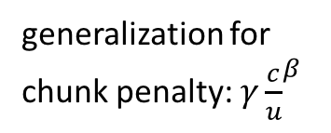
METEOR also allows flexible matching
content vs
function word split
generalization for
chunk penalty: $γ{\frac{c}{u}}^{β}$
inflection
Jim went home
Joe goes home
Jim walks home
synonym
How much credit? What counts as a match?
Depends on the version of METEOR you're using
This is why I believe METEOR didn't catch on as well as BLEU

Slide 54
METEOR vs BLEU
METEOR calculates precision and recall, so only one reference can be used
If multiple references, take the one that gives highest score
Can't use half of one reference, half of another
METEOR is a per-sentence metric
Good for certain kinds of optimization
There are single-sentence BLEU approximations
METEOR has semantic similarity-based matching
target language-dependent resources are needed
lots of small details regarding how to apply this; hampered METEOR's growth

Slide 59
2011 WMT Evaluation Metrics results

Slide 60
Automated Metrics: Conclusions
Essential tool for system development
Not fully suited for ranking systems of different types
BLEU: dominant metric
easy to calculate
not good for single-sentence scores
METEOR: also popular
various versions try to do different kinds of approximate matching
Evaluation metrics still an open challenge

Slide 62
Learning From Data
Parallel Corpora (sentence-aligned)
Canadian Hansards (French-English parliamentary proceedings; 10m words)
Europarl Parliamentary Proceedings (21-way parliamentary proceedings; 10m-50m words/lang)
GALE/BOLT Chinese-English Arabic-English corpora (news, blogs, chat; 300m words each)
Monolingual Corpora
Gigaword (1.7b words English news)
Clueweb (100b English words scraped from web)
Wikipedia monolingual corpora (20m-1.7b words in 23 langs)

Slide 63
Learning From Data
What is the best translation?
Sicherheit -> security
Sicherheit -> safety
Sicherheit -> certainty
Context matters!
Sicherheitspolitik -> security policy 1580
Sicherheitspolitik -> safety policy 13
Sicherheitspolitik -> certainty policy 0
Lebensmittelsicherheit -> food security 51
Lebensmittelsicherheit -> food safety 1084
Lebensmittelsicherheit -> food certainty 0
Rechtssicherheit -> legal security 156
Rechtssicherheit -> legal safety 5
Rechtssicherheit -> legal certainty 723
14,516
counts in European
parliament corpus
10,015
334

Slide 64
Learning From Data
Which is most fluent?
police disrupted the demonstration
police broke up the demonstration
police dispersed the demonstration
police ended the demonstration
police dissolved the demonstration
police stopped the demonstration
police suppressed the demonstration
police shut down the demonstration
2,140
66,600
25,800
762
2,030
722,000
1,400
2,040
hits on google

Slide 65
How do we learn word translations?
We're given sentence pairs
If we see the exact sentence we know how to translate it
How do we break a sentence down?
Barabara ya Mwenge-Morocco nyumba zinatakiwa kubomolewa.
Swahili
houses along the Mwenge-Morocco road are supposed to be demolished.
English
If I see "nyumba" again, how do I translate it?

Slide 66


To a computer, this might as well be Centauri and Arcturan!
farok crrrok hihok yorok clok kantok ok-yurp = ??

Slide 67
It's not as hard as it looks!
1a. ok-voon ororok sprok .
1b. at-voon bichat dat .
4a. ok-voon anok drok brok jok .
4b. at-voon krat pippat sat lat .
What is Arcturan for "ok-voon"?
How did you know?

Slide 90
This is more or less how the Rosetta Stone was cracked!

Slide 91
What Did We Just Do?
The connections between words are called an alignment
Word alignments between sentence pairs are the core statistics used in machine translation
We intuitively discovered them
How to programatically find them?

